Slide 1


“Analytical modeling of stresses and strains
for nanocomposite structures
- opportunities and challenges“
Assoc. prof. PhD Tatyana Petrova
Bulgarian Academy of Sciences, Institute of Chemical Engineering (IChE-BAS)
Under the financial support of Bulgarian National Science Fund for project КП-06-Н57/3/15.11.2021,
“Optimal safe load and geometry for layered nanocomposites under thermomechanical loading”
1ST SEMINAR ON INVESTIGATIONS AND MODELING OF NANOCOMPOSITES STRUCTURES, 25 APRIL, 2023, IChE-BAS, SOFIA, BULGARIA

Slide 2
content of the study
Brief review on papers for analytical modeling of nanocomposites (2000-2023):
analytical models – definitions, examples, results
Examples of analytical solutions applications to nanocomposites
Our contribution (papers in the project) – results and discussion
Conclusions
1ST SEMINAR ON INVESTIGATIONS AND MODELING OF NANOCOMPOSITES STRUCTURES, 25 APRIL, 2023, IChE-BAS, SOFIA, BULGARIA

Slide 3
There are about 60 papers found, corresponding to the keywords:
– “analytical solution +nanocomposite” AND “shear-lag+nanocomposites” :
10 papers are
Realized and published
By the Project team
Under the project
КП-06-K57/3/15.11.21
during 2021-2023
1ST SEMINAR ON INVESTIGATIONS AND MODELING OF NANOCOMPOSITES STRUCTURES, 25 APRIL, 2023, IChE-BAS, SOFIA, BULGARIA

Slide 4
Types of analytical models used to predict stresses and strains in nanocomposites:
Classified by their dimension:
1D – shear-lag, non-linear shear-lag, partial debonding & total debonding models,
cohesive shear-lag
2D – 2D shear-lag, plate theory, continuum mechanics principles, variational approaches,
stress-function method
3D – 3D shear-lag, micromechanical modeling, multiscale models
Classified by the elasticity/plasticity law acting to the nanocomposite – linear elastic
or cohesive
In the next few slides a basic definitions of terms in continuum mechanics, as well as
basic shear-lag model description should be presented, in solutions and graphic results.
1ST SEMINAR ON INVESTIGATIONS AND MODELING OF NANOCOMPOSITES STRUCTURES, 25 APRIL, 2023, IChE-BAS, SOFIA, BULGARIA

Slide 5
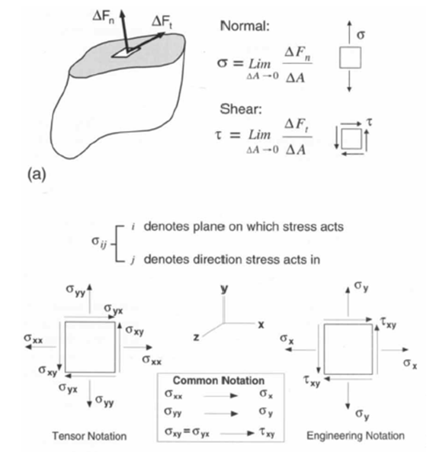
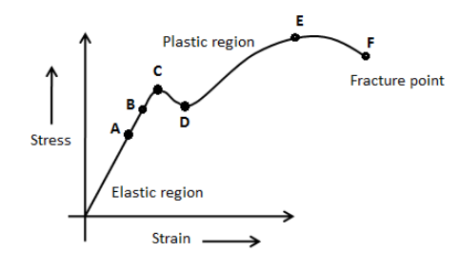
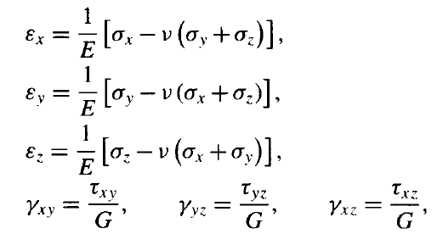
Dillard, 2002
Stresses and strains are related through constitutive equations; for linear elastic,
homogeneous, isotropic materials, these relations include:
where
E is Young's modulus or modulus of elasticity,
G is the shear modulus or modulus of rigidity,
v is a Poisson's ratio
1ST SEMINAR ON INVESTIGATIONS AND MODELING OF NANOCOMPOSITES STRUCTURES, 25 APRIL, 2023, IChE-BAS, SOFIA, BULGARIA

Slide 6
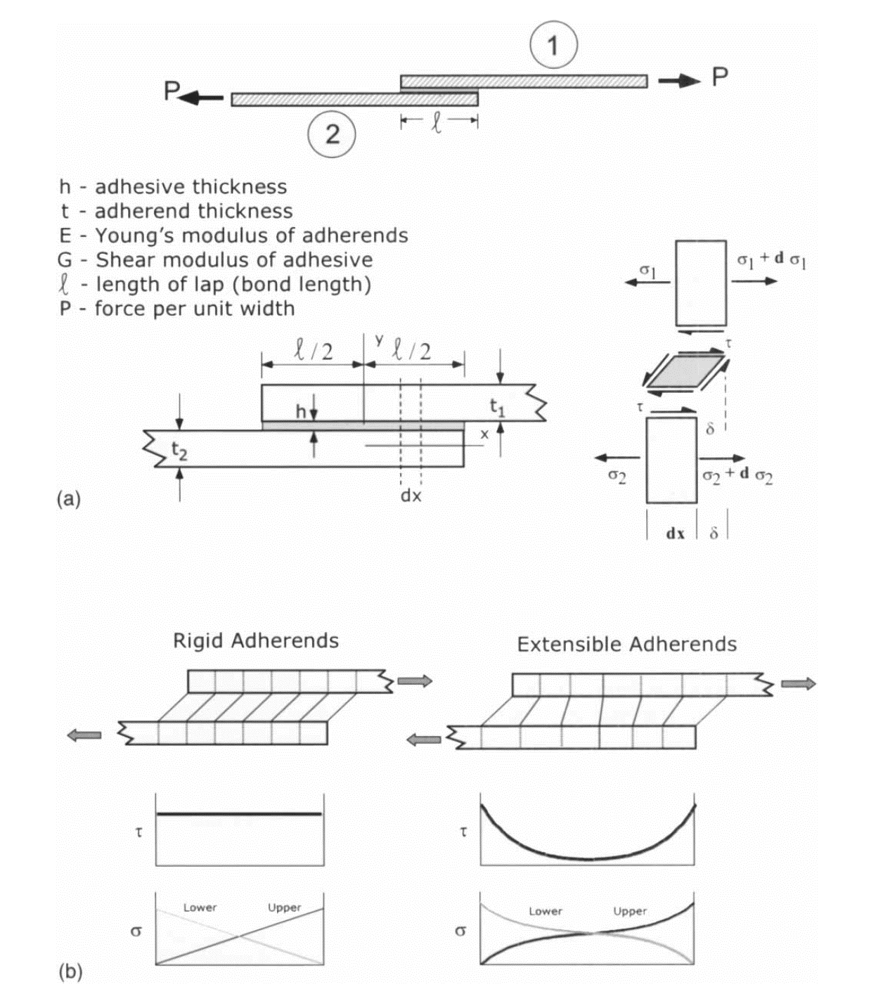
Dillard, 2002 – SHEAR-LAG MODEL for Single lap-joint
The shear lag model, first published by Volkersen in 1938, and then re-considered by Cox in 1952 for fiber-matrix, is one of the most fundamental concepts in the transfer of load between two members joined by either discrete connections, such as mechanical fasteners, or by a continuous layer such as an adhesive.
For any type of bonded joint involving adherends laid side by side and loaded axially in tension or compression, the adhesive layer serves to transfer load from one adherend to the other through shear stresses distributed along the length of the bond.
The upper and lower adherends are denoted by 1 and 2, respectively. Each adherend has a Young's modulus E; and a thickness t. The adhesive has a shear modulus of G and a thickness of h. The joint length is L, as shown in Figure.
If the adherends are relatively rigid, the transfer occurs in a more uniform fashion, with load being gradually transferred across the bond plane at a fairly uniform rate.
If the adherends are noticeably deformable in the axial direction, however, significant peaks in the shear stresses will occur at the ends of the joints.
1ST SEMINAR ON INVESTIGATIONS AND MODELING OF NANOCOMPOSITES STRUCTURES, 25 APRIL, 2023, IChE-BAS, SOFIA, BULGARIA

Slide 7

Dillard, 2002 – SHEAR-LAG MODEL …
How to obtain shear-lag solution?
1ST SEMINAR ON INVESTIGATIONS AND MODELING OF NANOCOMPOSITES STRUCTURES, 25 APRIL, 2023, IChE-BAS, SOFIA, BULGARIA

Slide 8
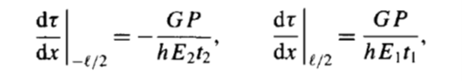
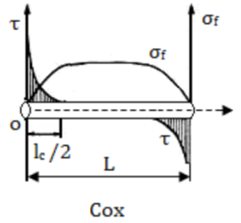
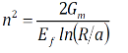
Dillard, 2002 – SHEAR-LAG MODEL…
Boundary conditions:
The final solution for the shear-lag model of the lap joint, P is the axial load per unit width of the joint :
Taklal et al, 2018 – Cox shear-lag solution for fiber/matrix
where
E_{f} is the Young modulus of the fiber, G_{m} shear modulus of the matrix,
ɛ₁ is the applied strain, a, R, are respectively the radius of the fiber and the matrix,
L is the fiber length, x is the variation of the length of the fiber,
r variation of rate of the matrix , s=L/a is the aspect ratio of the fiber,
n is a constant
1ST SEMINAR ON INVESTIGATIONS AND MODELING OF NANOCOMPOSITES STRUCTURES, 25 APRIL, 2023, IChE-BAS, SOFIA, BULGARIA

Slide 9
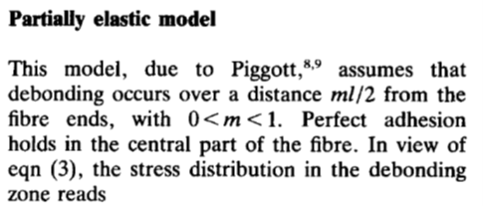
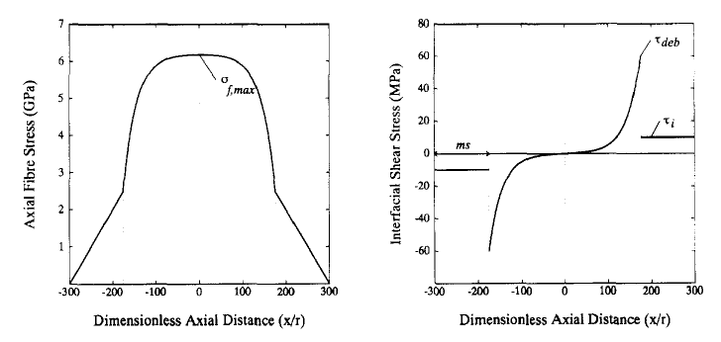
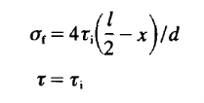
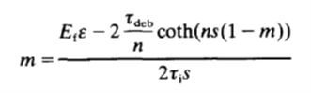
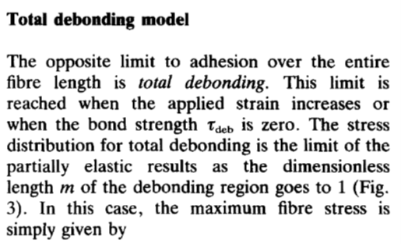
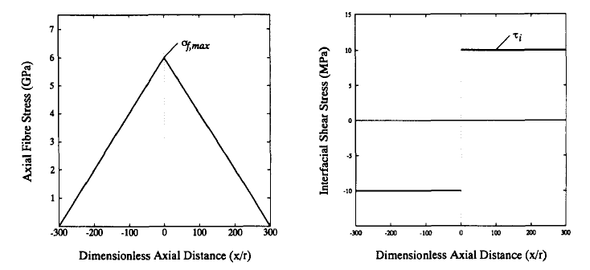
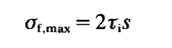
Lacroax et al, 1992
Partial and total debonding model for fiber/matrix
The dimensionless length of debonding zone is m
where s is the fibre aspect ratio s=l/d.
1ST SEMINAR ON INVESTIGATIONS AND MODELING OF NANOCOMPOSITES STRUCTURES, 25 APRIL, 2023, IChE-BAS, SOFIA, BULGARIA

Slide 10
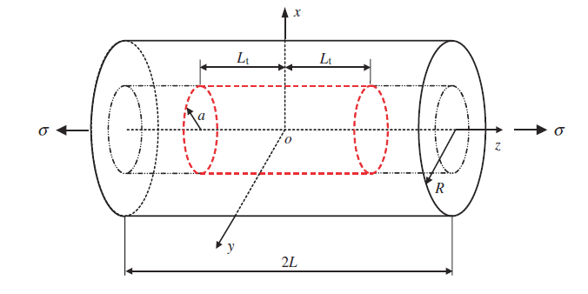
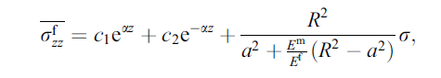
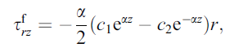
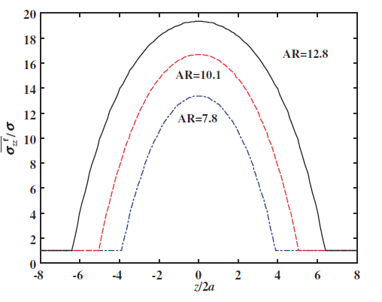
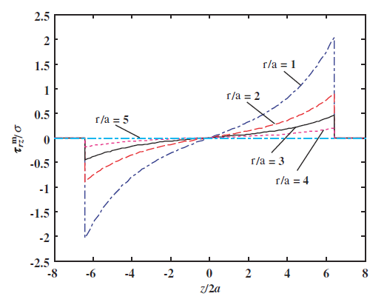
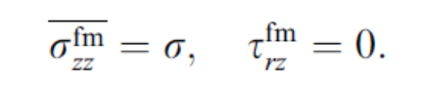
EXAMPLES OF SHEAR-LAG MODEL SOLUTIONS FOR CARBON NANOTUBES/MATRIX
Gao and Li, 2005 – SWCNT/polymer
Solutions for axial and shear stresses in the reinforced region (-Lt < z < Lt),
Solution in the pure matrix regions
(-L < z < -Lt and Lt < z < L)
1ST SEMINAR ON INVESTIGATIONS AND MODELING OF NANOCOMPOSITES STRUCTURES, 25 APRIL, 2023, IChE-BAS, SOFIA, BULGARIA

Slide 11
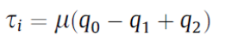
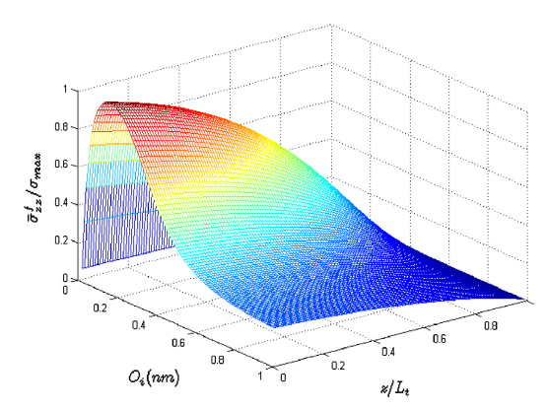
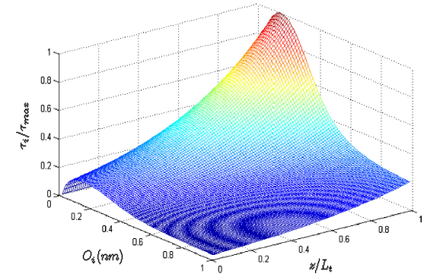
Ang & Ahmed, 2013 – shear-lag for SWCNT/polymer + New idea for interface shear stress τ_{i} modeling:
where μ is the coefficient of friction at the nanotube matrix interface,
q₀, q₁ and q₂ are the residual stress due to differential thermal contraction, the radial stress due to Poisson’s contraction and the cohesive stress caused by vdW force acting as pressure at the non-bonded interface, respectively.
1ST SEMINAR ON INVESTIGATIONS AND MODELING OF NANOCOMPOSITES STRUCTURES, 25 APRIL, 2023, IChE-BAS, SOFIA, BULGARIA

Slide 12
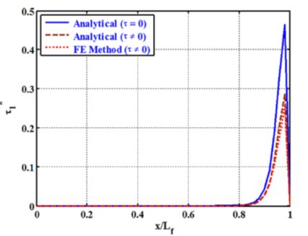
Kundalwal et al., 2014 -3 phase shear-lag with 3D static loads – cylindrical fuzzy fiber CNT /polyimide
1ST SEMINAR ON INVESTIGATIONS AND MODELING OF NANOCOMPOSITES STRUCTURES, 25 APRIL, 2023, IChE-BAS, SOFIA, BULGARIA

Slide 13
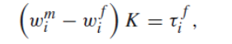
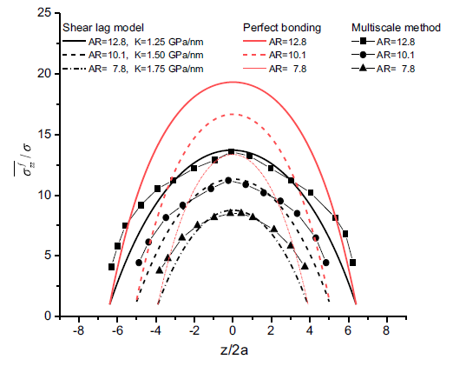
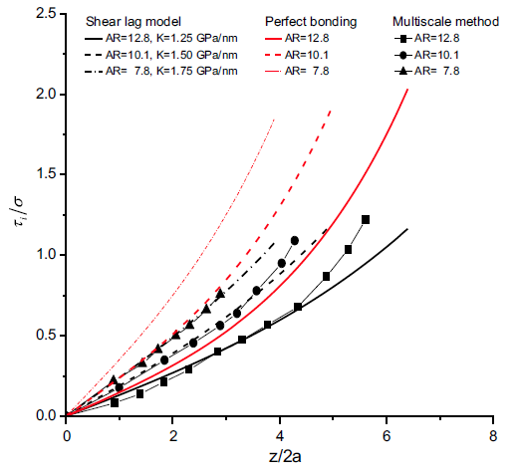
He et al, 2019 – shear-lag for SWCNT +adding stiffness parameter K to interface shear stress(ISS)
α depends now on the parameter K – interface spring stiffness parameter
1ST SEMINAR ON INVESTIGATIONS AND MODELING OF NANOCOMPOSITES STRUCTURES, 25 APRIL, 2023, IChE-BAS, SOFIA, BULGARIA

Slide 14
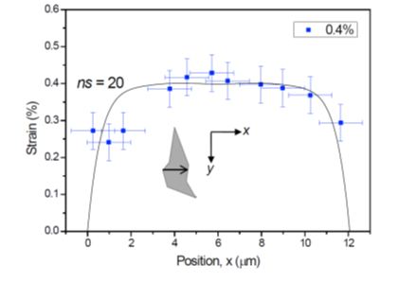
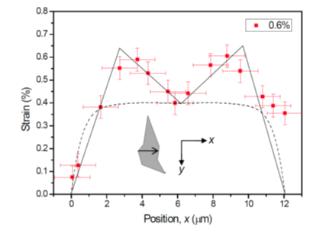
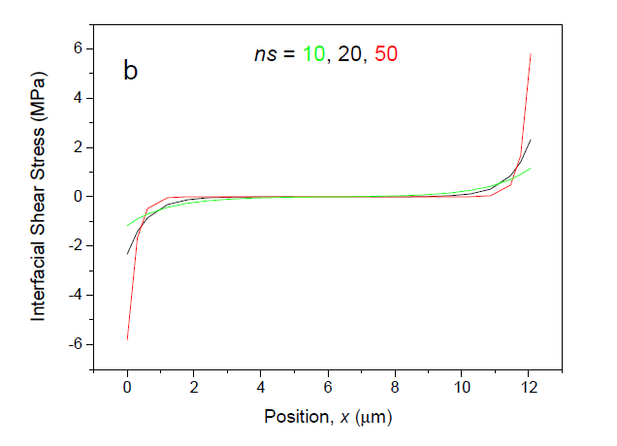
EXAMPLES OF SHEAR-LAG MODEL SOLUTIONS FOR NANOCOMPOSITES
Gong et al., 2010 and 2012, Graphene/SU-8/PMMA - shear lag model
1ST SEMINAR ON INVESTIGATIONS AND MODELING OF NANOCOMPOSITES STRUCTURES, 25 APRIL, 2023, IChE-BAS, SOFIA, BULGARIA

Slide 15
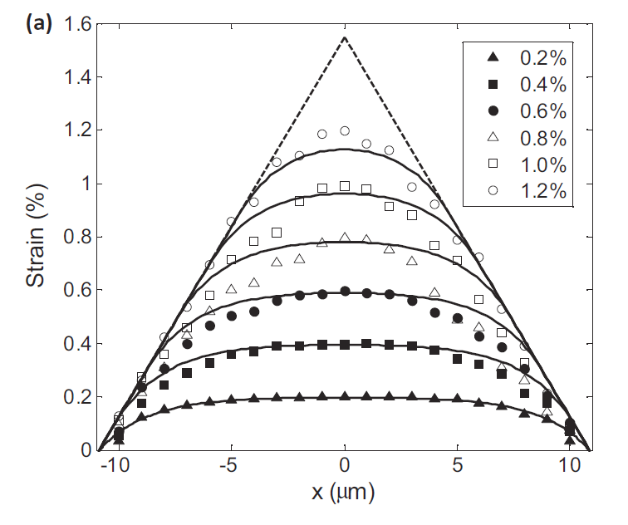
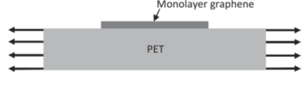
Jiang et al., 2013 – Graphene/PET
Non-linear shear-lag
- accounts for interfacial sliding when the interfacial shear stress exceeds a critical value
where k_{m} is the effective surface stiffness
of the elastomer (assumed to be a constant).
1ST SEMINAR ON INVESTIGATIONS AND MODELING OF NANOCOMPOSITES STRUCTURES, 25 APRIL, 2023, IChE-BAS, SOFIA, BULGARIA

Slide 16
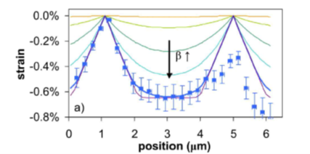
Bronsgeest et al., 2015 – GRAPHENE/COBALT, non-linear shear lag, wrinkles accounted
There are critical strain level of 0.2% beyond which sliding will occur, β = 1⋅106 m⁻¹.
The interfacial shear strength critical τ_{c} of 2.2±0.3 MPa
with G_{s} the shear modulus of the substrate, and t_{s} the thickness of the substrate =50 μm
1ST SEMINAR ON INVESTIGATIONS AND MODELING OF NANOCOMPOSITES STRUCTURES, 25 APRIL, 2023, IChE-BAS, SOFIA, BULGARIA

Slide 17
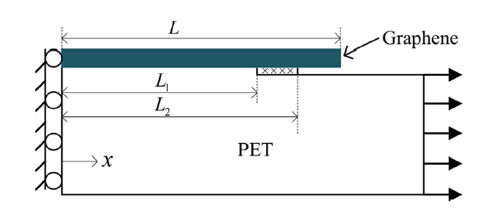
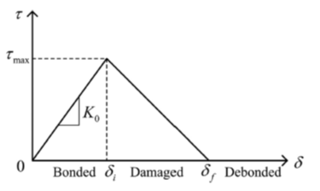
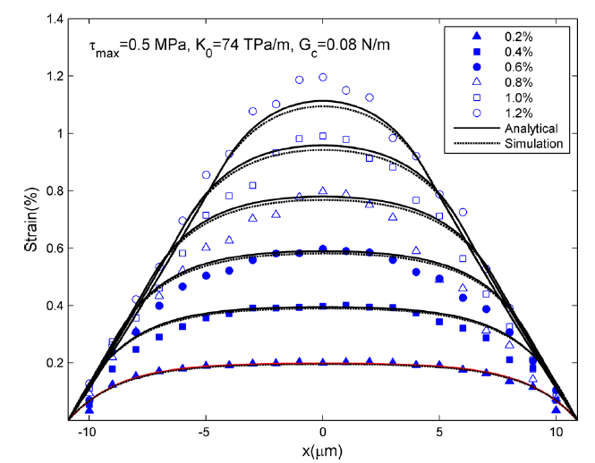
Guo & Zhu, 2015, GRAPHENE/PET - cohesive shear-lag, non-linear-shear-lag+FEM
constant stiffness K₀
1ST SEMINAR ON INVESTIGATIONS AND MODELING OF NANOCOMPOSITES STRUCTURES, 25 APRIL, 2023, IChE-BAS, SOFIA, BULGARIA

Slide 18
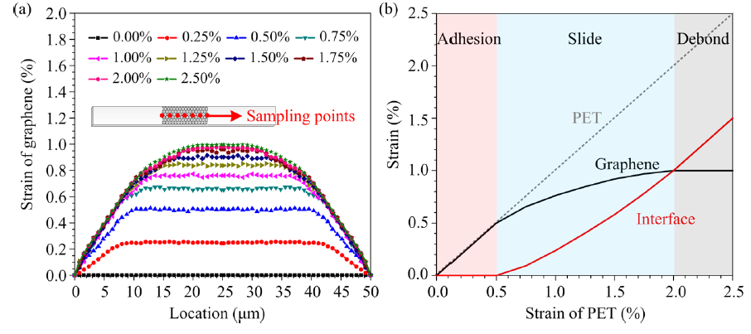
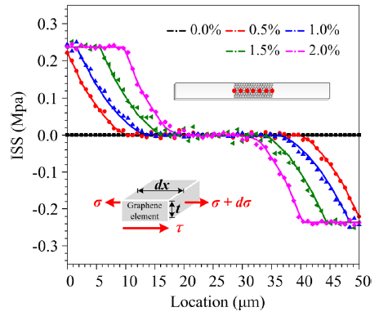
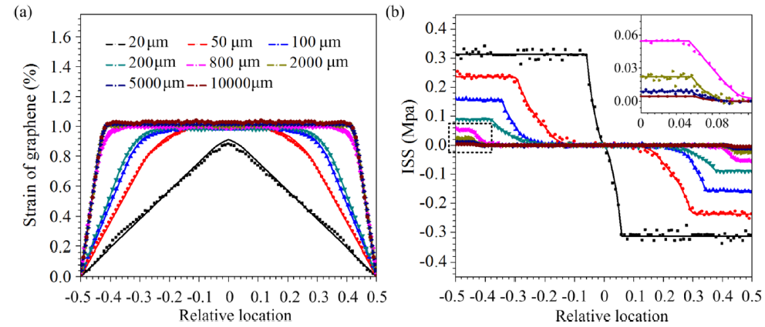
Xu et al., 2016, GRAPHENE/PET - shear-lag+ size effect of graphene flake on strains and ISS
L=50μm
L vary between
20 μm – 1 cm
1ST SEMINAR ON INVESTIGATIONS AND MODELING OF NANOCOMPOSITES STRUCTURES, 25 APRIL, 2023, IChE-BAS, SOFIA, BULGARIA

Slide 19
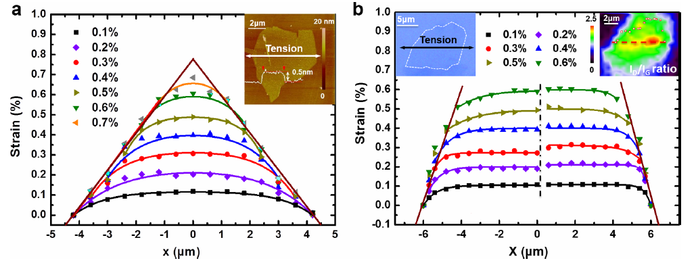
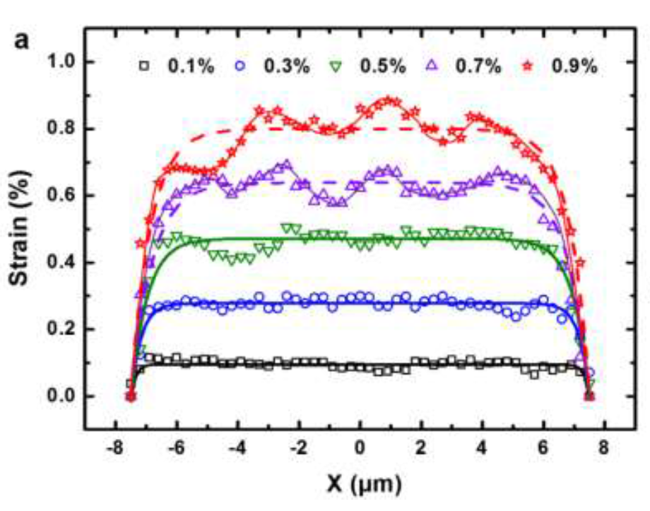
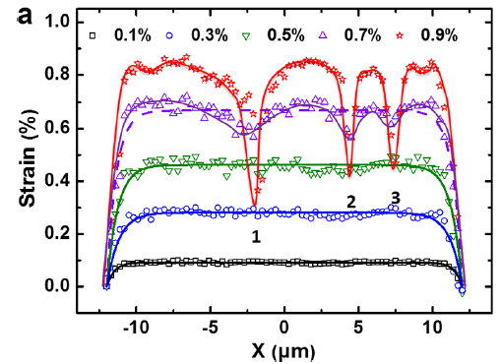
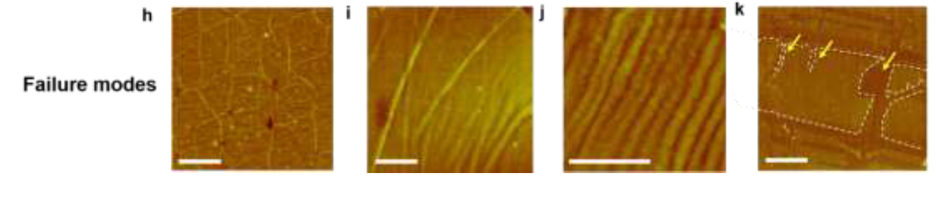
Wang et al., 2016, GRAPHENE/PMMA,
non-shear-lag model - for pristine and partially oxidazed graphene
1ST SEMINAR ON INVESTIGATIONS AND MODELING OF NANOCOMPOSITES STRUCTURES, 25 APRIL, 2023, IChE-BAS, SOFIA, BULGARIA

Slide 20
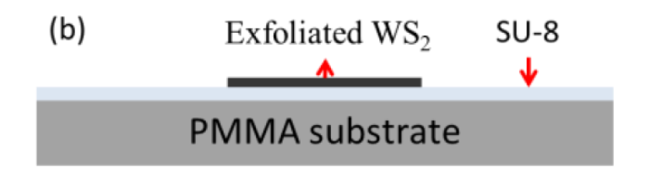
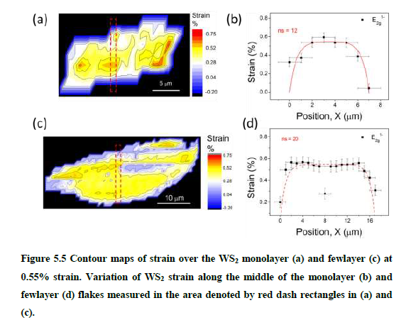
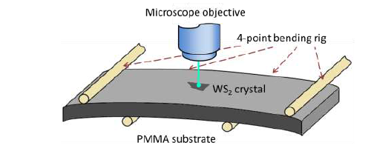
Wang F., PHD, 2016, WS₂/SU8/PMMA - shear lag model
1ST SEMINAR ON INVESTIGATIONS AND MODELING OF NANOCOMPOSITES STRUCTURES, 25 APRIL, 2023, IChE-BAS, SOFIA, BULGARIA

Slide 21
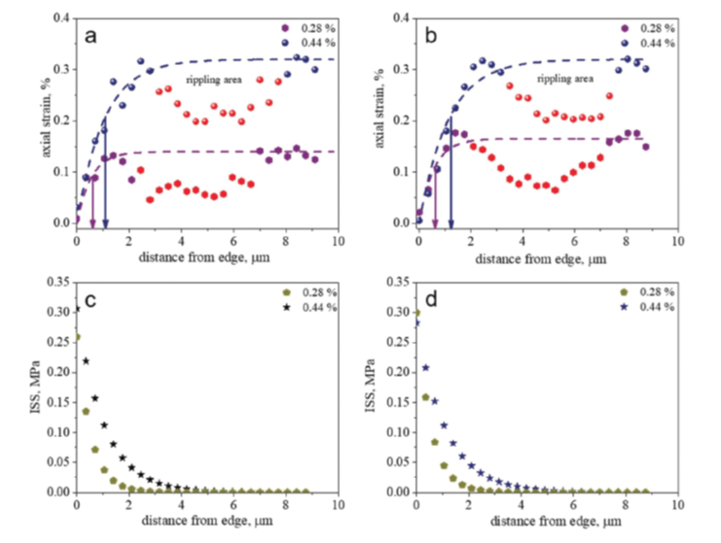
Manikas et al., 2019, graphene micro-ribbon/PMMA- modified shear-lag+adding inverse length parameter l₀ for stress transfer length prediction
1ST SEMINAR ON INVESTIGATIONS AND MODELING OF NANOCOMPOSITES STRUCTURES, 25 APRIL, 2023, IChE-BAS, SOFIA, BULGARIA

Slide 22
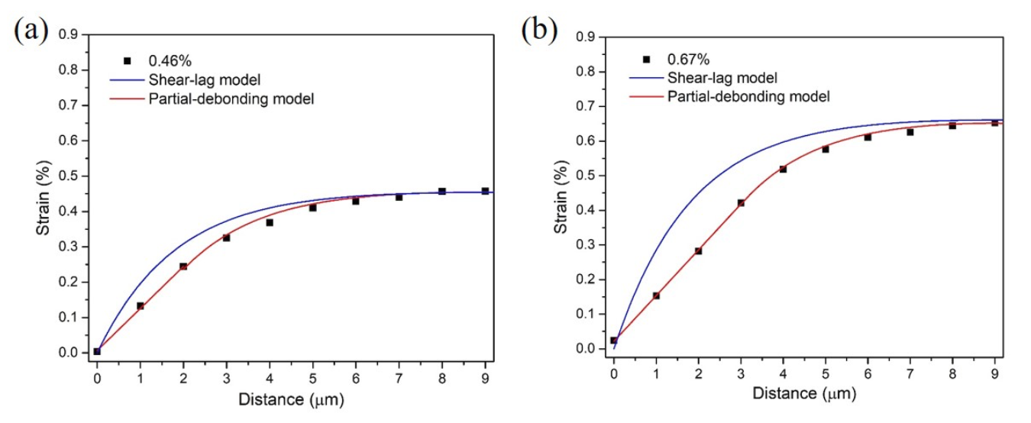
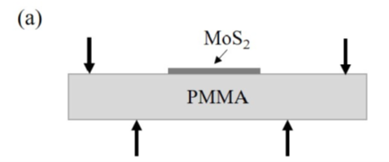
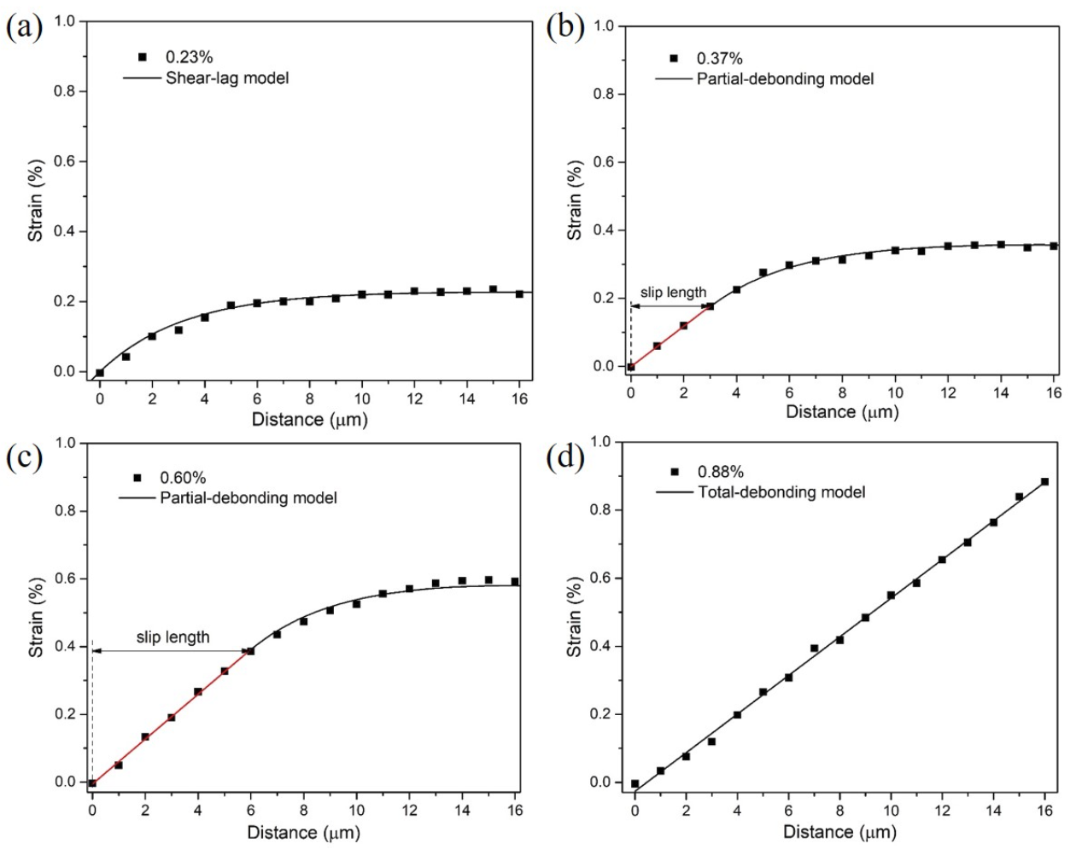

Dong et al., 2022, MOS₂/PMMA, mono & few layers - shear-lag, partial debonding and totally debonding models
mono
1ST SEMINAR ON INVESTIGATIONS AND MODELING OF NANOCOMPOSITES STRUCTURES, 25 APRIL, 2023, IChE-BAS, SOFIA, BULGARIA

Slide 23






Du et al., 2022, 2 specimens, 1 or 2 Interfaces, Grahene/MOS₂/PET and MOS₂/PET –
shear-lag+force balance
1ST SEMINAR ON INVESTIGATIONS AND MODELING OF NANOCOMPOSITES STRUCTURES, 25 APRIL, 2023, IChE-BAS, SOFIA, BULGARIA

Slide 24

Liu et al., 2022, TI₃C₂ M-XENE/PMMA, shear-lag
Weimiao Wang, 2021, PhD, hBN /PMMA, shear-lag
1ST SEMINAR ON INVESTIGATIONS AND MODELING OF NANOCOMPOSITES STRUCTURES, 25 APRIL, 2023, IChE-BAS, SOFIA, BULGARIA

Slide 25

REN ET AL, 2022, TOP AND BOTTOM GRAPHENE/FORMVAR/PDMS , extended shear-lag+MD simulations
1ST SEMINAR ON INVESTIGATIONS AND MODELING OF NANOCOMPOSITES STRUCTURES, 25 APRIL, 2023, IChE-BAS, SOFIA, BULGARIA

Slide 26


Shao et al., 2023, ELASTOPLASTIC AgNW/PDMS, treated and untreated PDMS – non-linear and bi-linear shear lag solutions+FEM
1ST SEMINAR ON INVESTIGATIONS AND MODELING OF NANOCOMPOSITES STRUCTURES, 25 APRIL, 2023, IChE-BAS, SOFIA, BULGARIA

Slide 27


Our work 2021-2023
Fig. 1. Representative volume element (RVE) of three-layered nanocomposite structure
1ST SEMINAR ON INVESTIGATIONS AND MODELING OF NANOCOMPOSITES STRUCTURES, 25 APRIL, 2023, IChE-BAS, SOFIA, BULGARIA

Slide 28
1ST SEMINAR ON INVESTIGATIONS AND MODELING OF NANOCOMPOSITES STRUCTURES, 25 APRIL, 2023, IChE-BAS, SOFIA, BULGARIA

Slide 29
C. Stress fields
2D-continuum differential equations of equilibrium for the overlap zone in the absence of body forces:
,
(7a)
.
(7b)
All stresses in the layers are obtained integrating by y Eqs. (7a, or 7b) and satisfying the BCs and CCs, Eqs. (1-6).
The stresses in each layer are expressed in terms of a single stress potential function (axial stress of the 1st layer σ₁ and its first and second derivatives:
Layer (1):
,
,
,
,
.
(8)
Layer (a):
,
,
.
(9)
Layer (2):
,
,
,
.
(10)
1ST SEMINAR ON INVESTIGATIONS AND MODELING OF NANOCOMPOSITES STRUCTURES, 25 APRIL, 2023, IChE-BAS, SOFIA, BULGARIA

Slide 30

The 2D strains can be calculated by eq.(11) in each layer, using eqs. (8-10) as:
(11)
The total strain energy of the structure is:
(12)
Substitute Eqs. (8-11) in Eq. (12), after integration by y, the following equation is obtained:
(13)
The minimum of complementary strain energy functional can be found according to Euler-Lagrange equation of the variational calculus. This equation leads to the following ODE of 4th order with constant coefficients D_{i} :
(14)
1ST SEMINAR ON INVESTIGATIONS AND MODELING OF NANOCOMPOSITES STRUCTURES, 25 APRIL, 2023, IChE-BAS, SOFIA, BULGARIA

Slide 31
The discriminant of the respective characteristic 4th order equation (bi-quadratic) of Eq. (14)
can be positive or negative, so the roots can be real or complex numbers, or mixed ones. The
sign of the discriminant depends on the thicknesses and material properties of the structure
layers, e.g from coefficients D_{i}, but not depend on the external tensile load .
The general solutions for real – Eq. (15) and complex roots – Eq. (16) for axial stress σ₁ are worked out :
(15)
(16)
C_{i} and M_{i} are the integration constants in the model solution, determined from the boundary conditions. Constant A in the solutions depends on the value of external static load σ₀ and Young’s modulus of the first and third layer in the structure as A=D₅ /2D₁ or
After obtaining the solution for σ₁ all stresses in the layers (axial, normal (peel) and shear stresses) are determined as functions of σ₁ and its derivatives from Eqs. (8-10).
2D strains in the layers i=1,a,2, corresponding to each of the stress solutions – (15) or (16),
could be calculated by eqs. (11), when we have mechanical load only.
1ST SEMINAR ON INVESTIGATIONS AND MODELING OF NANOCOMPOSITES STRUCTURES, 25 APRIL, 2023, IChE-BAS, SOFIA, BULGARIA

Slide 32
In the case of thermo-mechanical loading, i.e., in the presence of temperature field
we will have for 2D strains, that:
(17)
are the coefficients of thermal expansion of the layers, (1/K)
T and ΔT are the temperature and temperature difference, respectively.
The temperature T is supposed to be uniformly distributed in the layers.
For solutions in stresses (respectively, strains), only terms D₅ and resp. A, changes:
1ST SEMINAR ON INVESTIGATIONS AND MODELING OF NANOCOMPOSITES STRUCTURES, 25 APRIL, 2023, IChE-BAS, SOFIA, BULGARIA

Slide 33
NUMERICAL EXAMPLES AND MODEL VALIDATION of our 2d model
During the project, four nanocomposite structures are considered and used for validation of model stresses and strains solutions:
- monolayer graphene/SU-8/PMMA , mechanical loading – Gong L., PhD, 2012
three-layer graphene/SU-8/PMMA, mechanical and thermomechanical loading - Androulidakis et al., 2017
WS₂/SU-8/PMMA, mechanical loading – Wang F., PhD, 2017
Graphene/MoS₂/PET (PRELIMINARY RESULTS), mechanical loading – Du et al., 2022
For the model stress (15) and (16) and strain (11) and (17) calculation and figures preparation, Mathcad Prime v.6.0 and Sigma Plot, v.13.0 have been used.
1ST SEMINAR ON INVESTIGATIONS AND MODELING OF NANOCOMPOSITES STRUCTURES, 25 APRIL, 2023, IChE-BAS, SOFIA, BULGARIA

Slide 34







results
Figure 2. Visualization of the model stresses in the layers of Graphene/SU-8/PMMA, for Case 1 – eq.(15).
1ST SEMINAR ON INVESTIGATIONS AND MODELING OF NANOCOMPOSITES STRUCTURES, 25 APRIL, 2023, IChE-BAS, SOFIA, BULGARIA

Slide 35









results
Figure 3. Visualization of the model strains in the layers of Graphene/SU-8/PMMA, for Case 1 – eq. (11) with (15).
1ST SEMINAR ON INVESTIGATIONS AND MODELING OF NANOCOMPOSITES STRUCTURES, 25 APRIL, 2023, IChE-BAS, SOFIA, BULGARIA

Slide 36


results
Fig. 4 Comparison of our model predictions for the graphene axial strain eq. (11) with Gong’s shear lag model and its experimental Raman spectroscopy data:
for external strain of 0.4%,
(b) – for external strain of 0.6%.
1ST SEMINAR ON INVESTIGATIONS AND MODELING OF NANOCOMPOSITES STRUCTURES, 25 APRIL, 2023, IChE-BAS, SOFIA, BULGARIA

Slide 37




results
Figure 5. Visualization of the model stresses in the layers of WS₂/SU-8/PMMA, for Case 2 –eq.16 and comparison with shear-lag model in Wang, 2017 .
1ST SEMINAR ON INVESTIGATIONS AND MODELING OF NANOCOMPOSITES STRUCTURES, 25 APRIL, 2023, IChE-BAS, SOFIA, BULGARIA

Slide 38



results
Fig. 6. Comparison between the obtained model strain solutions (5a) and (5b) and both shear-lag prediction and the experimental data of Wang (2017) for strain in monolayer flake WS₂, at external strain of 0.35% and 0.55% (top) and for few-layer WS₂ at external strain of 0.55% (bottom) – eq.11
1ST SEMINAR ON INVESTIGATIONS AND MODELING OF NANOCOMPOSITES STRUCTURES, 25 APRIL, 2023, IChE-BAS, SOFIA, BULGARIA

Slide 39









Fig. 7 Comparison of the axial strains (left), shear strains (center) and peel strains (right) in the layers of the
few-layer Graphene/SU-8/PMMA at mechanical (grey), thermal (red) and thermo-mechanical (green) loading – eq. 17.
1ST SEMINAR ON INVESTIGATIONS AND MODELING OF NANOCOMPOSITES STRUCTURES, 25 APRIL, 2023, IChE-BAS, SOFIA, BULGARIA

Slide 40


Fig. 8 Comparison of the model axial strains in the graphene layer of the nanocomposite structure at mechanical external strain 0.3% and 0.8 % , with experimental data of Androulidakis et al., 2017 – eq. 11.
Fig. 9 Comparison of the model axial strains in the graphene layer of the nanocomposite structure Graphene/MoS₂/PET at mechanical external strain 0.6% with experimental data of Du et al., 2022-eq. 11.
PRELIMINARY RESULTS, UNPUBLISHED
1ST SEMINAR ON INVESTIGATIONS AND MODELING OF NANOCOMPOSITES STRUCTURES, 25 APRIL, 2023, IChE-BAS, SOFIA, BULGARIA

Slide 41
conclusions
Analytical “shear-lag” type models give simple 1D solutions, validated by experiments and FEM, for prediction of stresses and strains in composite and nanocomposites structures, subjected generally in tension loading.
The correct application of shear-lag models for matrix-fiber nanocomposites is constrained - first in the elastic zone only, secondly by the volume of added fibers, and also, from the fiber length and interaction between fibers. Different models are derived to cover these gaps.
Partial and total debonding models, as well as non-linear shear-lag create the “bridge” between predictions of stress transfer in elastic and plastic zone (cohesive shear-lag models and FEM simulations).
Analytical models allow adding of different effects to the stresses, especially to ISS, like interface spring stiffness constant, effects of residual stresses, due to the thermal and Poison contraction, effect of WdW forces, effect of sliding, etc., and obtain analytical solutions to describe a complex combination of external and internal factors, acting on the stress transfer in nanocomposites.
1ST SEMINAR ON INVESTIGATIONS AND MODELING OF NANOCOMPOSITES STRUCTURES, 25 APRIL, 2023, IChE-BAS, SOFIA, BULGARIA

Slide 42
Conclusions…
Analytical 1D solutions can be combined with other solution technics and model results – FEM, atomistic modeling, multiscale modeling, BEM, plate theory, etc., to enhance the research efforts to obtain valuable results and new knowledge for stress transfer mechanism in the nanocomposites.
Analytical solutions give a possibility to perform parametric analysis and determine and predict the factors, which influence on the stress transfer, e.g, ISS – geometry, external load, temperature, etc.
Our results show, that 2D stress-function method, first derived for three layered nanocomposite structure, subjected to mechanical/thermal/thermomechanical loading, is successfully applied for 4 different nanostructures and validated with literature data for stresses and strains. This method gives a opportunity to enhanced 1D solutions, accounting normal stresses and strains and takes into account the properties of Interface zone.
Up to now, 2D stress-function method analytical solutions are valid in elastic zone. Based on the parametric analysis for 4 investigated nanostructures, it was found, that the most important factors, influenced on the values of ISS, are external load and nano-layer length. Effect of temperature is better visible for axial and peel stresses than for shear ones.
1ST SEMINAR ON INVESTIGATIONS AND MODELING OF NANOCOMPOSITES STRUCTURES, 25 APRIL, 2023, IChE-BAS, SOFIA, BULGARIA

Slide 43







ACKNOWLEDGEMENTS
The author gratefully acknowledge
the Bulgarian National Science Fund for its financial support via the contract КП-06-Н57/3/15.11.2021, for project “Optimal safe load and geometry for layered nanocomposites under thermomechanical loading”
PROJECT TEAM
Thank you for your attention!
1ST SEMINAR ON INVESTIGATIONS AND MODELING OF NANOCOMPOSITES STRUCTURES, 25 APRIL, 2023, IChE-BAS, SOFIA, BULGARIA

